Slide 1
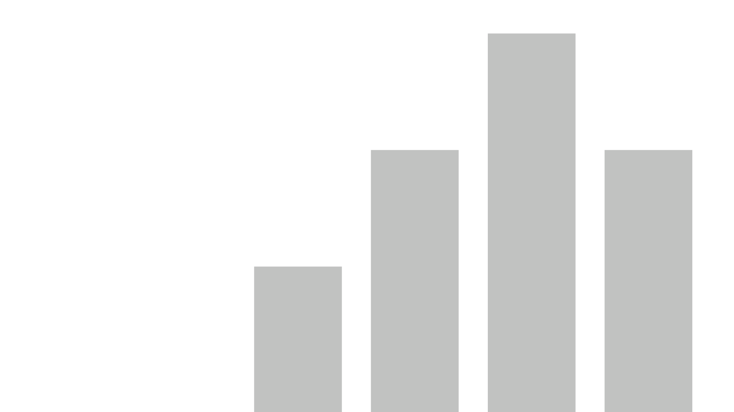


World Happiness Data Analysis
View in Power BI
Last data refresh:
2/17/2023 1:49:23 PM UTC
Downloaded at:
2/17/2023 1:50:44 PM UTC

Slide 2
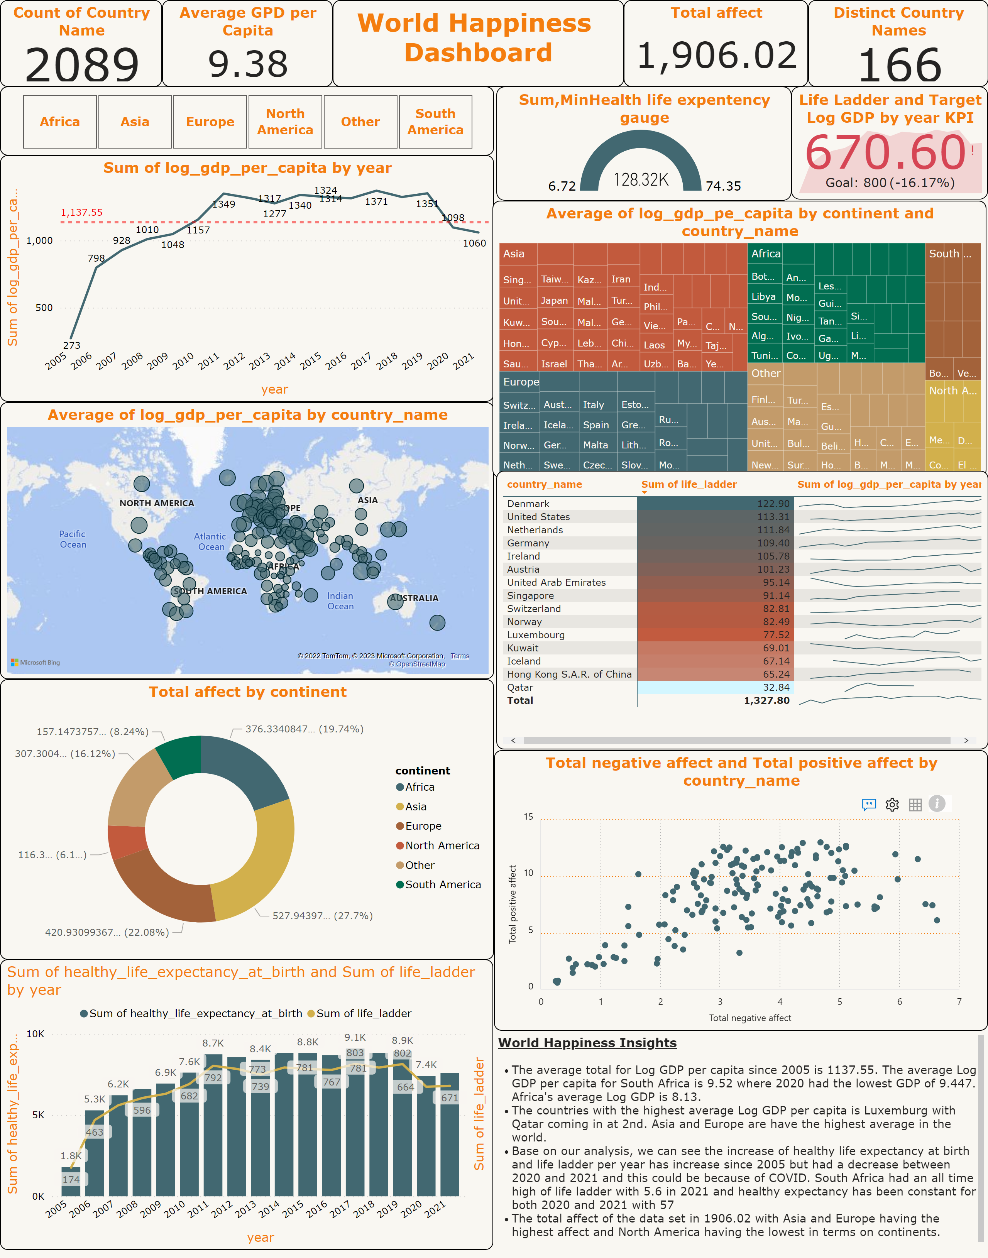
Dashboard
Notes:
map
No alt text provided
Count of Country Name
No alt text provided
textbox
No alt text provided
Total affect
No alt text provided
Distinct Country Names
No alt text provided
Average GPD per Capita
No alt text provided
performanceBubbleChartFBAAA829CB604E5CAB4F21729F233294
No alt text provided
Life Ladder and Target Log GDP by year KPI
No alt text provided
Sum,MinHealth life expentency gauge
No alt text provided
slicer
No alt text provided
lineChart
No alt text provided
pivotTable
No alt text provided
donutChart
No alt text provided
Average of log_gdp_pe_capita by continent and country_name
No alt text provided
textbox
No alt text provided
lineClusteredColumnComboChart
No alt text provided

Slide 3
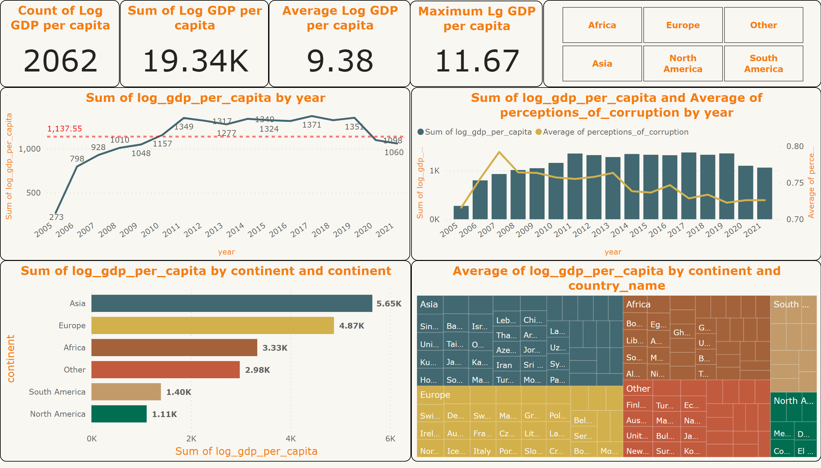
Log GDP Per Capita Analysis
Notes:
Count of Log GDP per capita
No alt text provided
Sum of Log GDP per capita
No alt text provided
Maximum Lg GDP per capita
No alt text provided
barChart
No alt text provided
lineStackedColumnComboChart
No alt text provided
slicer
No alt text provided
lineChart
No alt text provided
Average Log GDP per capita
No alt text provided
treemap
No alt text provided

Slide 4
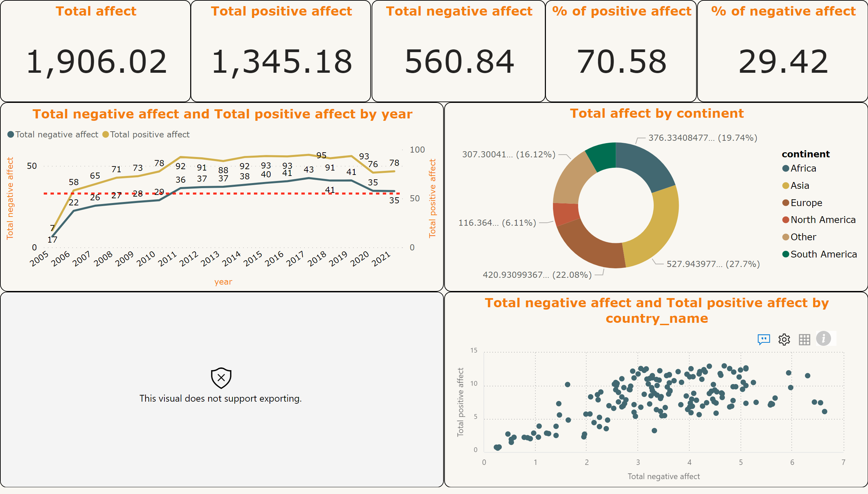
Positive and Negative Affect Analysis
Notes:
Total positive affect
No alt text provided
Total negative affect
No alt text provided
% of positive affect
No alt text provided
% of negative affect
No alt text provided
Total affect
No alt text provided
histogram42E8DF98F1244DB799B2A8A65DBCB226
No alt text provided
performanceBubbleChartFBAAA829CB604E5CAB4F21729F233294
No alt text provided
lineChart
No alt text provided
donutChart
No alt text provided

Slide 5
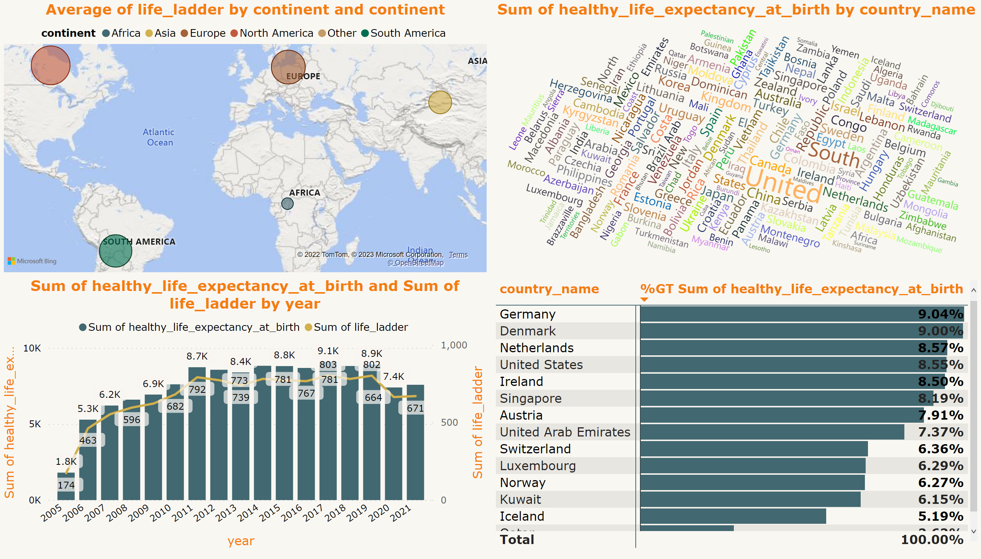
Life Ladder and Health expectancy analysis
Notes:
map
No alt text provided
pivotTable
No alt text provided
WordCloud1447959067750
No alt text provided
lineClusteredColumnComboChart
No alt text provided

